Slide 1


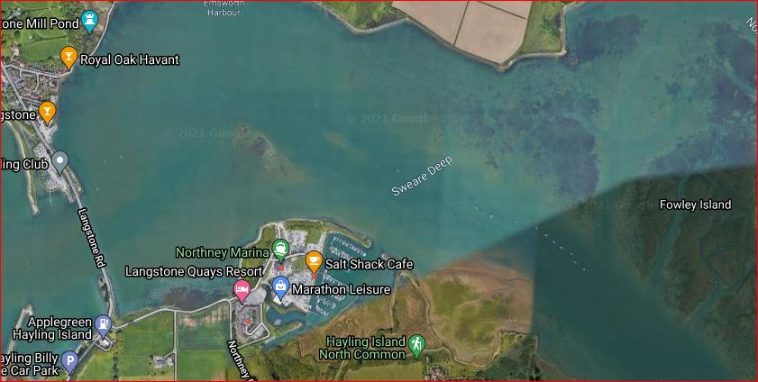
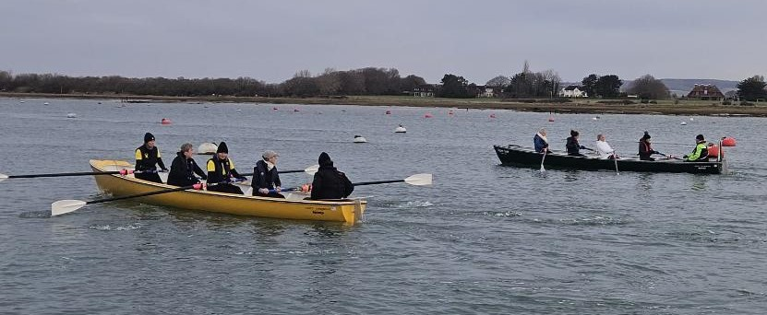
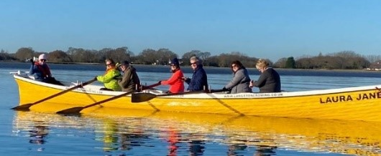
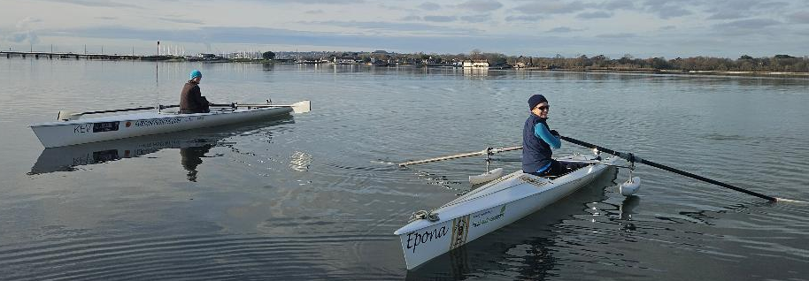
Chichester Harbour
TwixMass Event December 29th
From 09.00 to 12.00
Pairs racing
1K sprints
Multi-class boats
£10 Food and a Drink included

